Slide 2
Hello Welcome!
Lecture Week Two

Slide 3
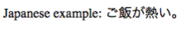
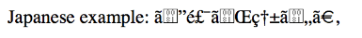
Let’s discuss <meta>
<head>
<meta charset="UTF-8">
</head>
<p>Japanese example: ご飯が熱い。</p>
UTF-8
Notes:
ISA is about internet and web technologies.

Slide 4
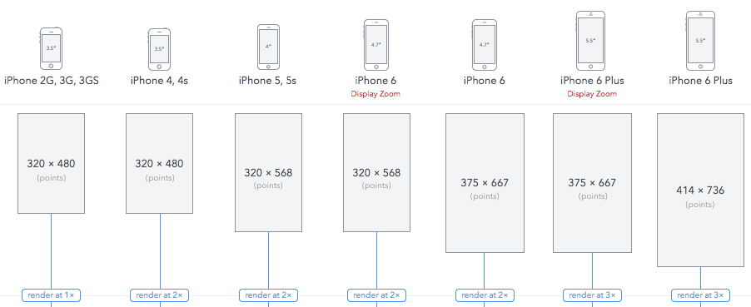
Viewport
<head>
<meta name="viewport" content="width=device-width, initial-scale=1.0">
</head>
https://experienceleague.adobe.com/docs/target/using/experiences/vec/mobile-viewports.html
Notes:
ISA is about internet and web technologies.

Slide 5
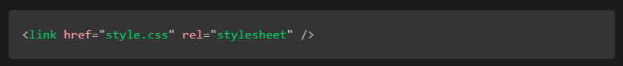
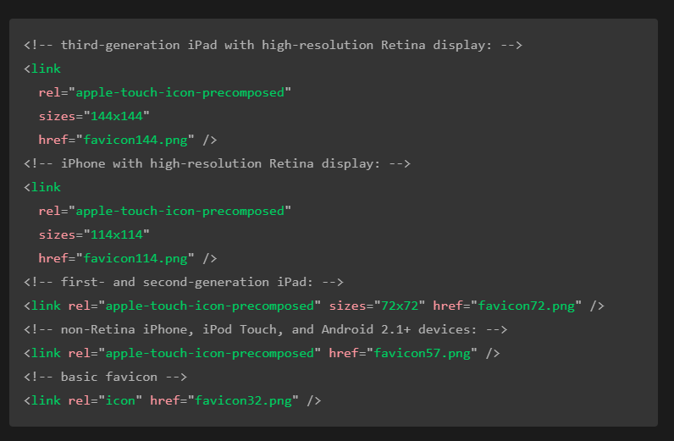
<link>: The External Resource Link element
Providing icons for different usage contexts
Notes:
ISA is about internet and web technologies.

Slide 6
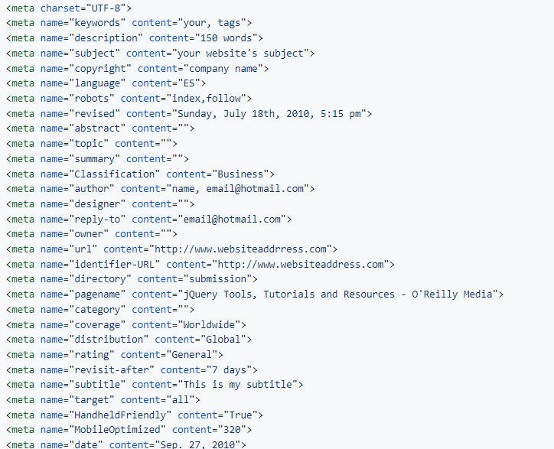
Meta Tag List
<meta name="twitter:title" content="Machine Learning Workshop"> <meta name="twitter:description" content="School for machines who can't learn good and want to do other stuff good too"/> <meta name="twitter:url" content="https://www.machinelearningworkshop.com/?src=twitter" /> <meta name="twitter:image:src" content="http://www.machinelearningworkshop.com/image/all.png"/> <meta name="twitter:image:alt" content="27 different home appliances" /> <meta name="twitter:creator" content="@estellevw"> <meta name="twitter:site" content="@perfmattersconf">
https://github.com/kevinSuttle/html-meta-tags
Notes:
ISA is about internet and web technologies.

Slide 7
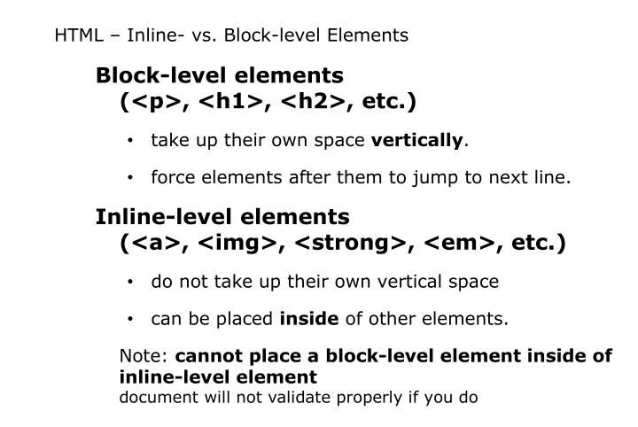
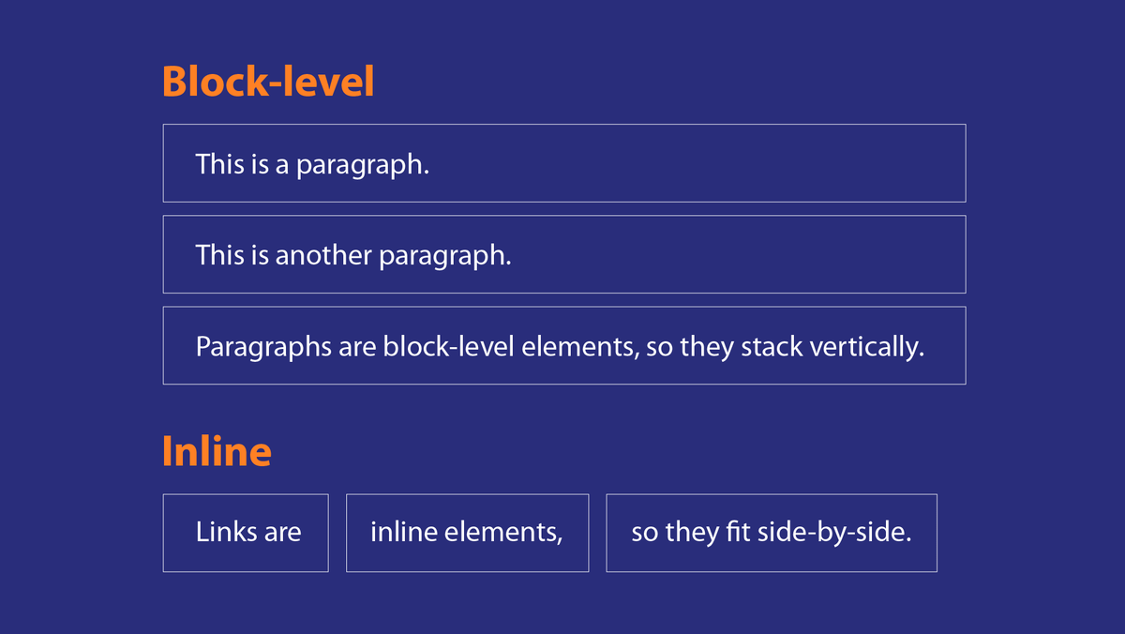
Block-level and Inline Elements
Notes:
ISA is about internet and web technologies.

Slide 8

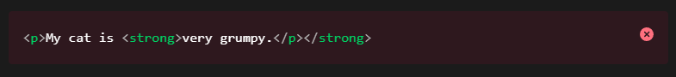
Nesting Elements
Notes:
ISA is about internet and web technologies.

Slide 9
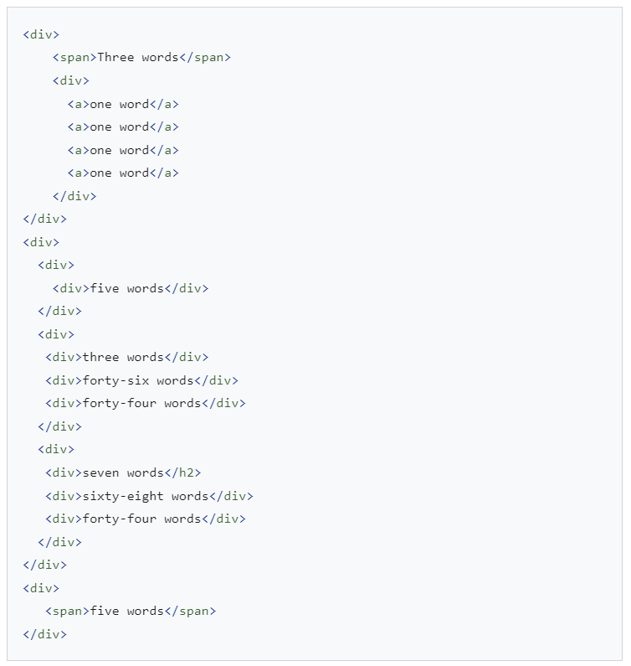
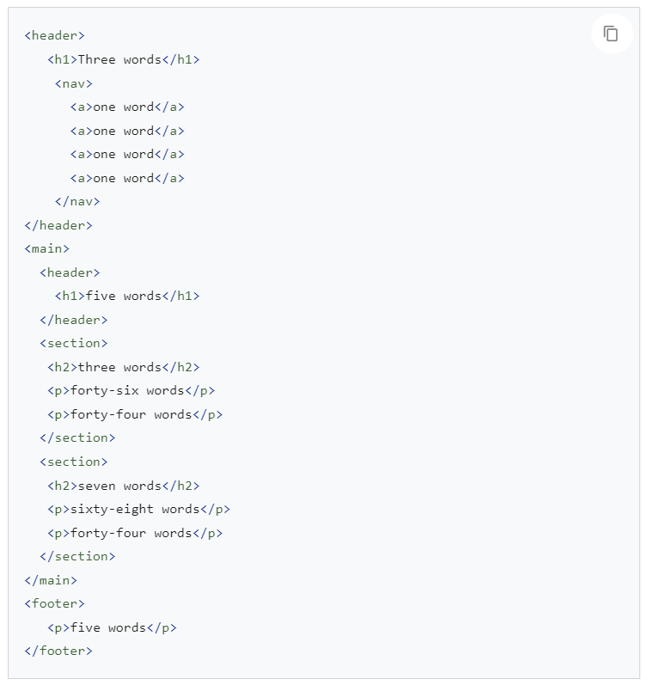
Semantic HTML

Slide 10
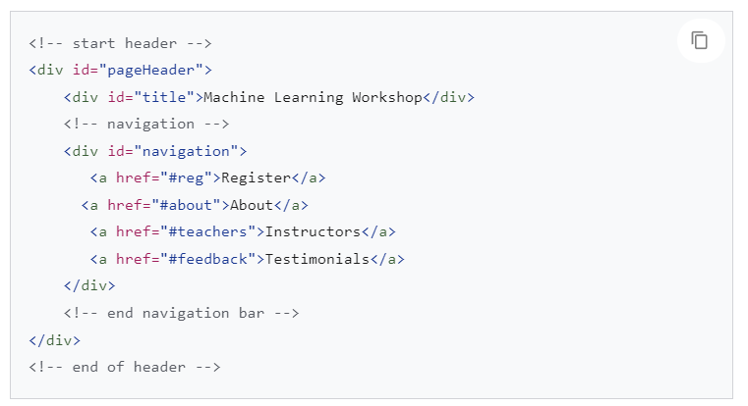
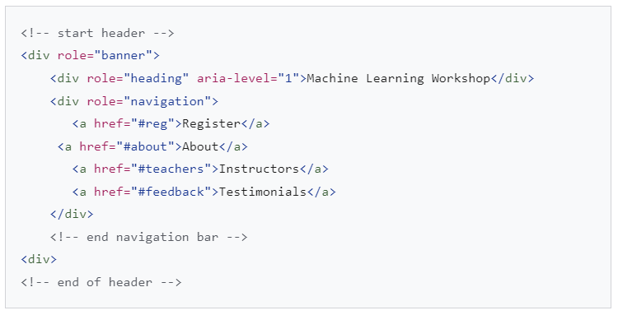
Headings and sections
Header
Notes:
ISA is about internet and web technologies.

Slide 11
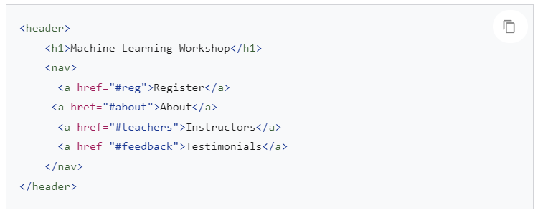
Notes:
ISA is about internet and web technologies.

Slide 12
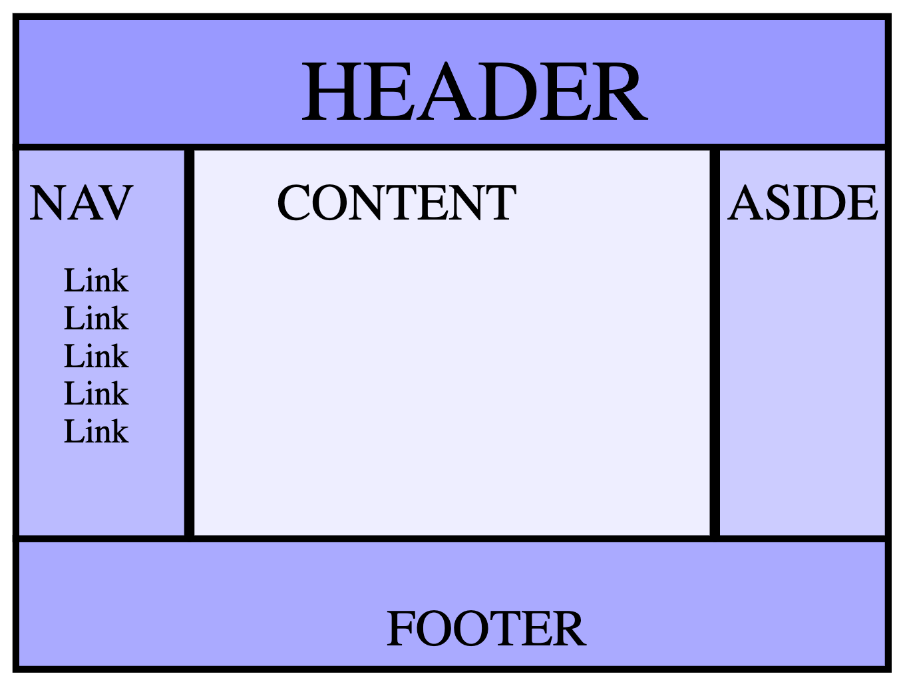
Document structure
holy grail layout

Slide 13
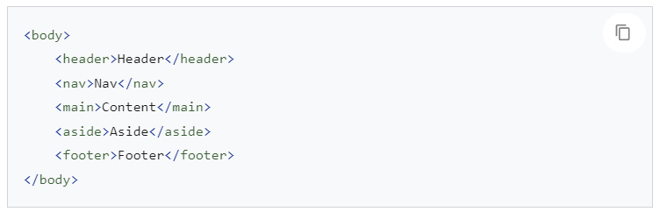
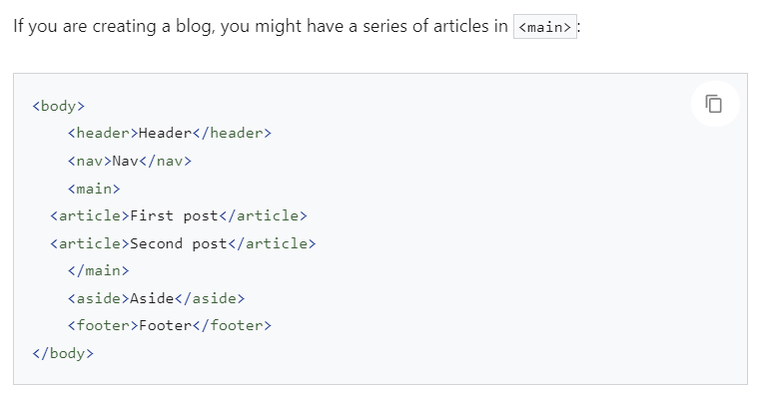
Notes:
ISA is about internet and web technologies.

Slide 14
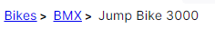
<nav>: The Navigation Section element
<nav class="crumbs">
<ol>
<li class="crumb"><a href="#">Bikes</a></li>
<li class="crumb"><a href="#">BMX</a></li>
<li class="crumb">Jump Bike 3000</li>
</ol>
</nav>

Slide 15
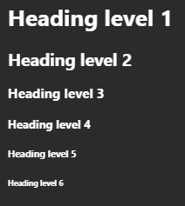
<h1>–<h6>: The HTML Section Heading elements
<h1>Heading level 1</h1>
<h2>Heading level 2</h2>
<h3>Heading level 3</h3>
<h4>Heading level 4</h4>
<h5>Heading level 5</h5>
<h6>Heading level 6</h6>
Heading information can be used by user agents to construct a table of contents for a document automatically.
Do not use heading elements to resize text. Instead, use the CSS font-size property.
Do not skip heading levels: always start from <h1>, followed by <h2> and so on.
Notes:
ISA is about internet and web technologies.

Slide 16
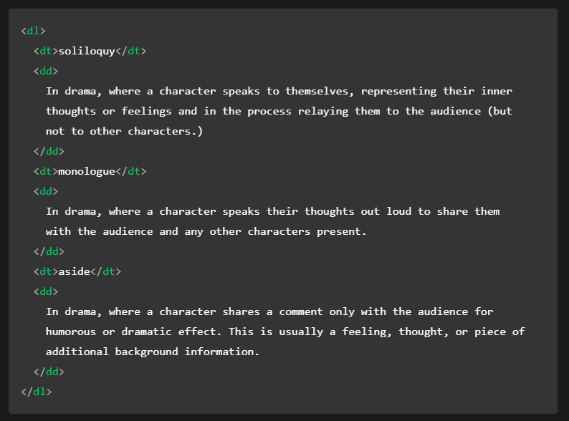
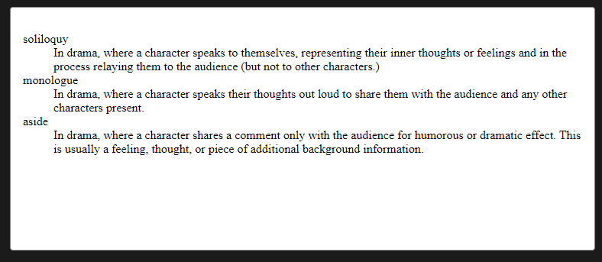
Advanced text formatting
Description list
Notes:
ISA is about internet and web technologies.

Slide 17
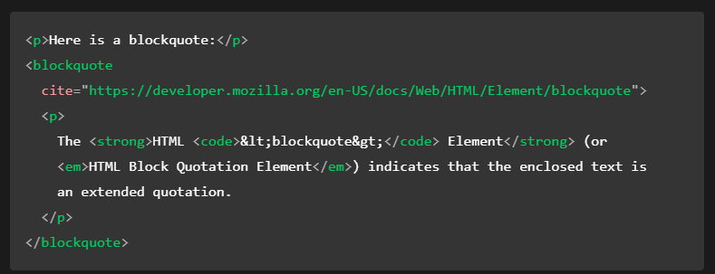
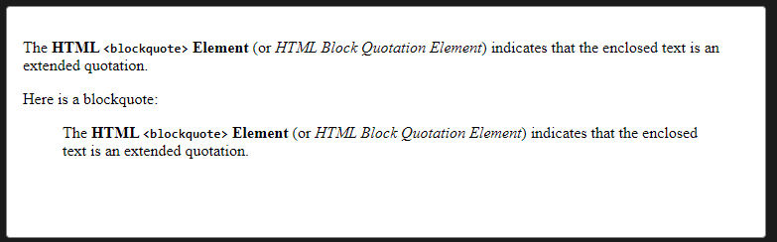
Blockquote
Notes:
ISA is about internet and web technologies.

Slide 18
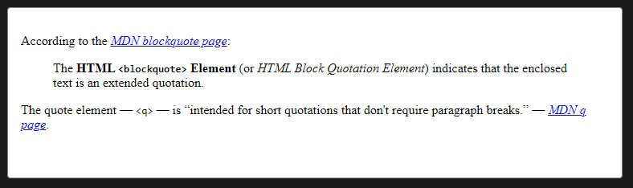
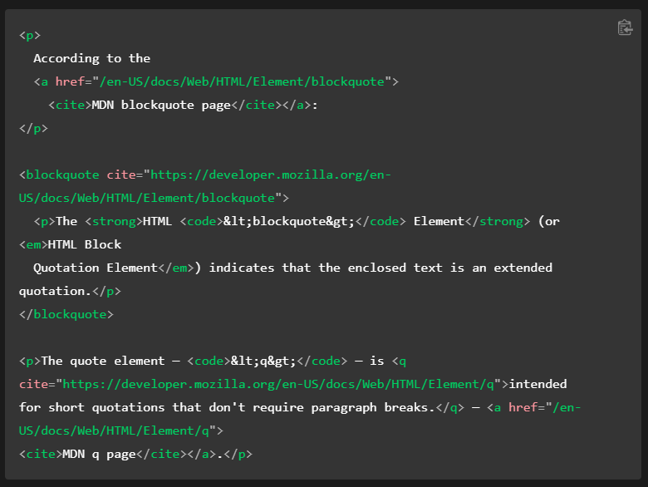
Citations
Notes:
ISA is about internet and web technologies.

Slide 19
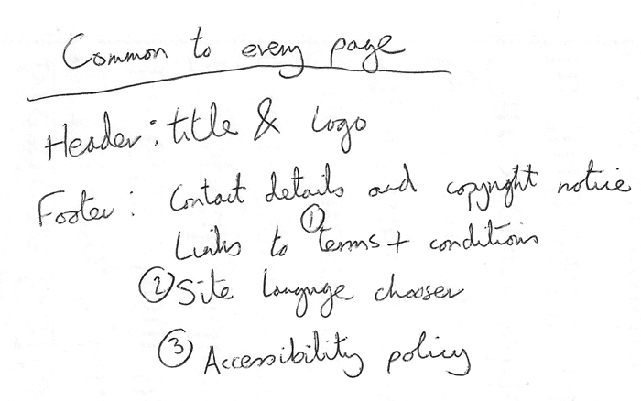
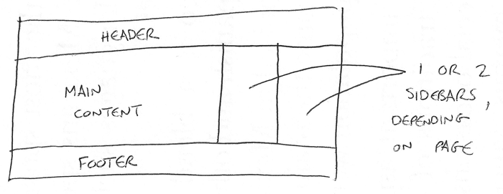
Planning a simple website
Information architecture

Slide 20
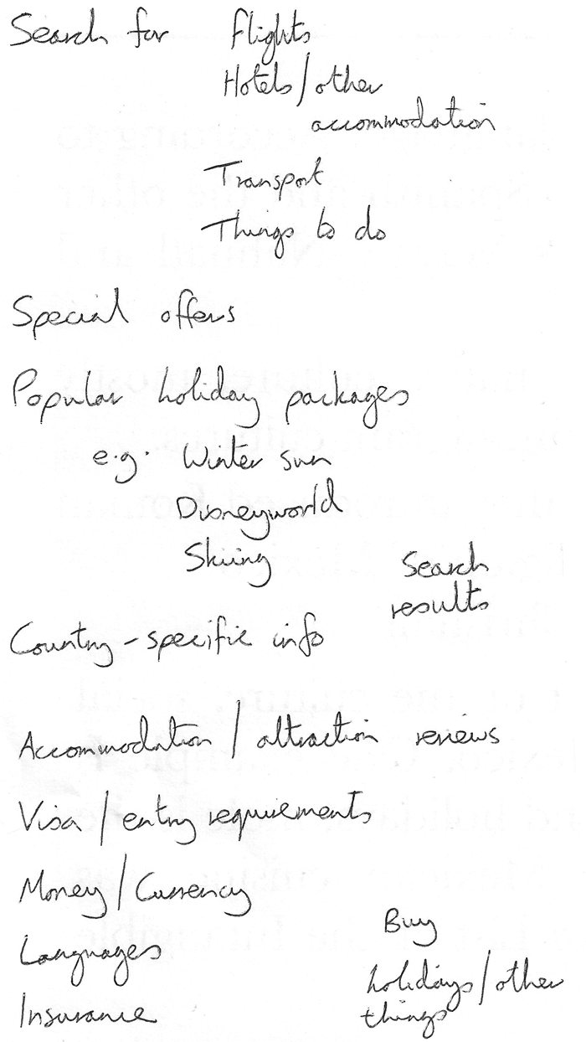

Slide 21
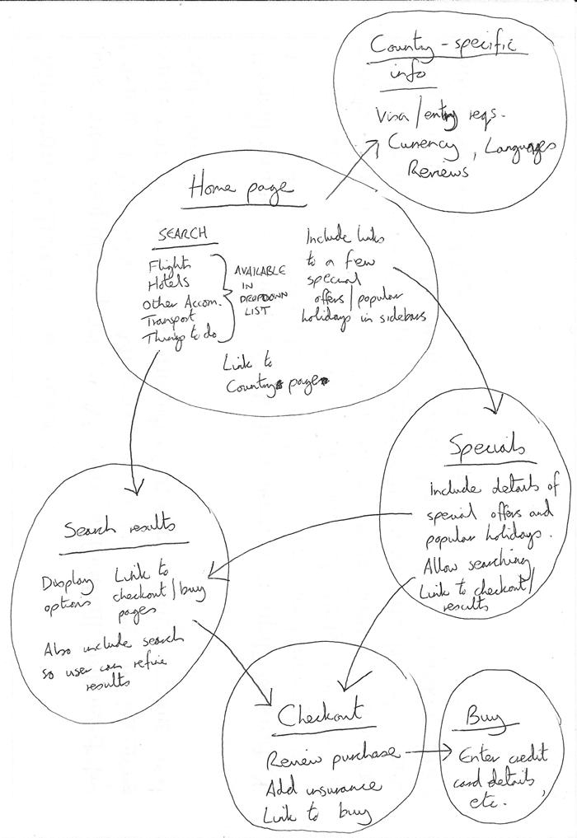
Sitemap

Slide 22
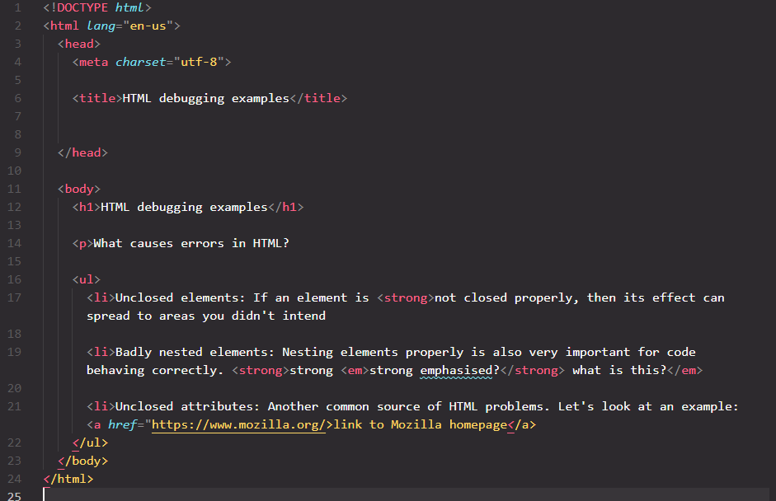
Debugging HTML

Slide 23
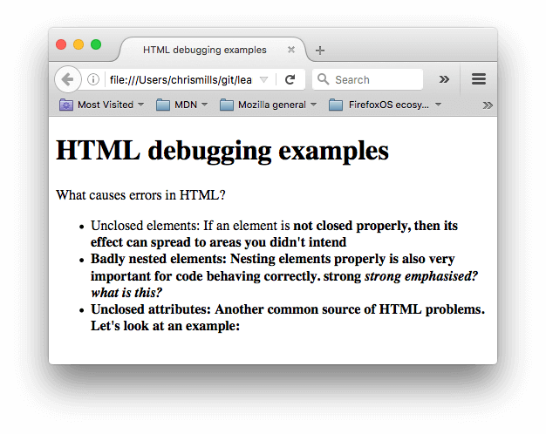

Slide 24
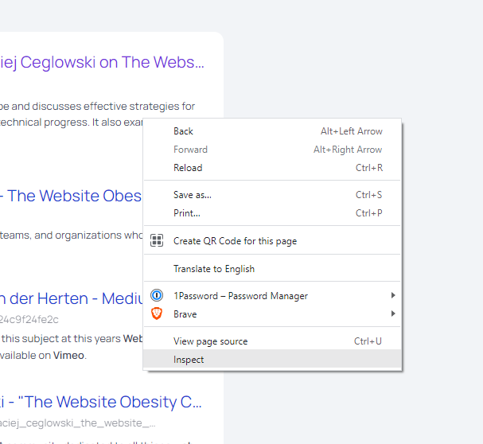
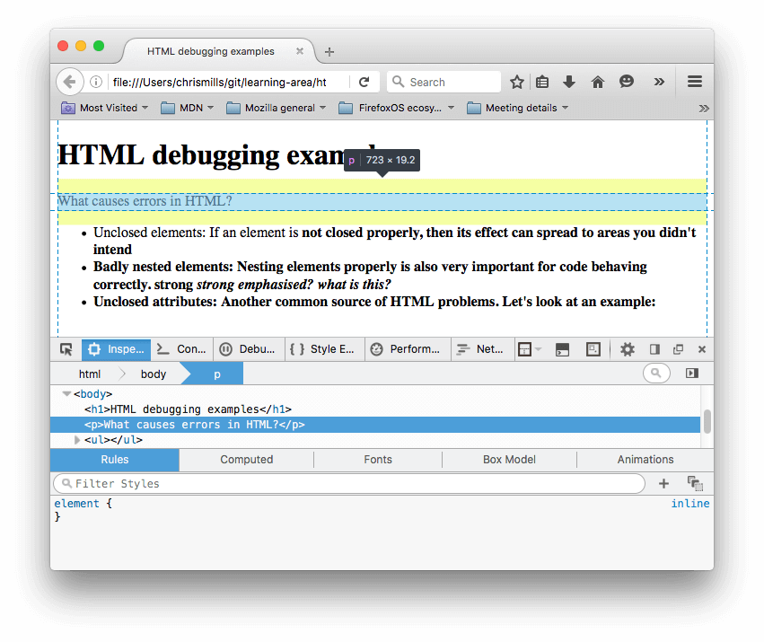

Slide 25
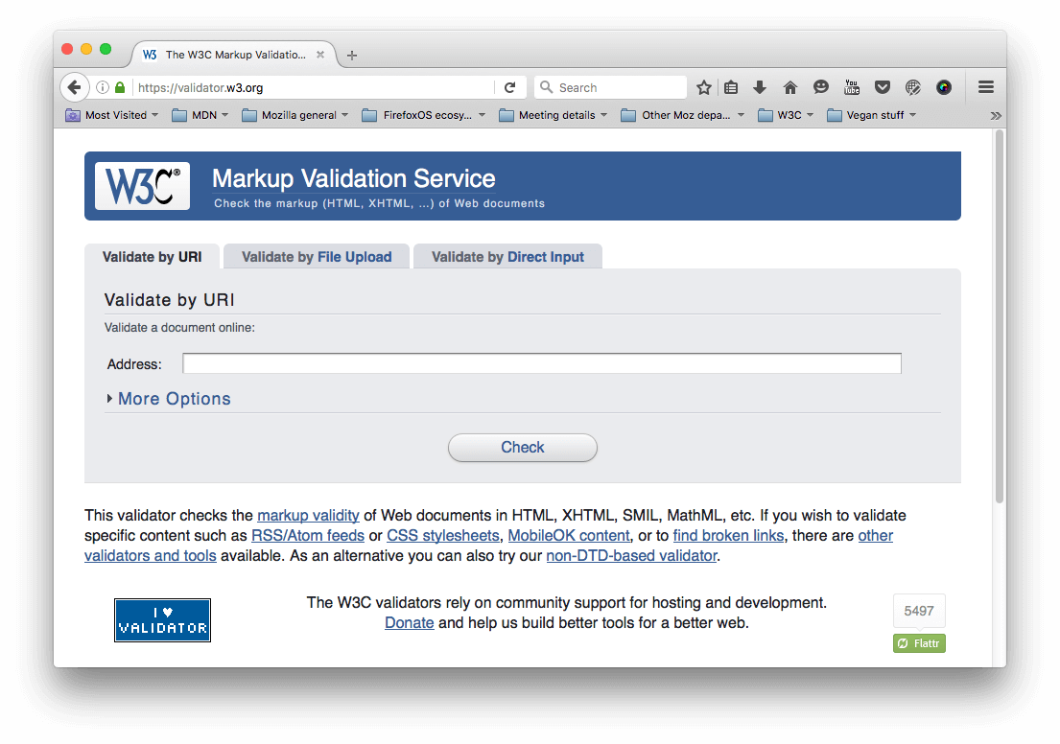
https://validator.w3.org/j

Slide 26
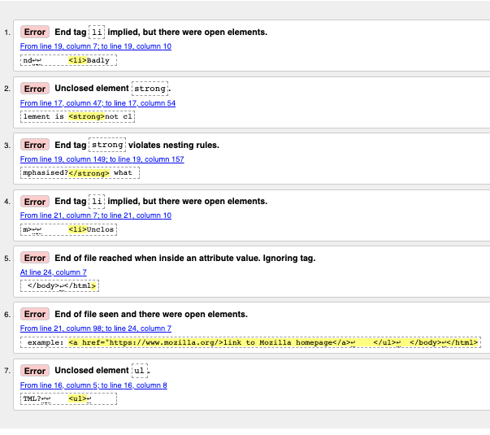

Slide 27
Want to Learn more?
HTML5 Doctor
HTML5: W3C Schools
HTML5: Tutorial Points

Slide 28
Thank you!

